Slide 1
Planetary Lander Using Phasic Policy Gradient
Priyanka Prabhath
Student No: 200599373
Supervisor: Dr. Angadh Nanjangud

Slide 2
Objective
To implement Phasic Policy gradient algorithm on a Lander problem.
To explore the different applications of Reinforcement Learning.

Slide 3
Motivation
With the advancement in technology, it is possible to implement newer and better implementations.
Exploring the possibilities of unmanned mission.
The need for autonomy in spacecrafts are has been prominent now more than ever.
With Reinforcement Learning techniques, It is possible to provide autonomy to spacecrafts and thus explore further distances especially when it gets difficult to communicate back to earth.

Slide 4
Reinforcement Learning
Mimics how humans and other beings learn in the real world
Based on trial and error
The agent receives reward signals from the environment when it takes a step in the environment
Main objective of the agent is to maximise the rewards obtained from the environment.

Slide 5
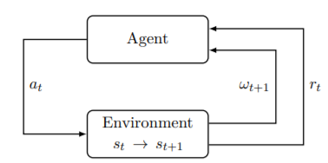
Reinforcement Learning
Agent puts in the action to the environment
The Environment takes a step from state St to state S(t+1)
Agent receives the new observation from the environment along with a reward signal obtained from the environment for taking a particular action at that state.

Slide 6
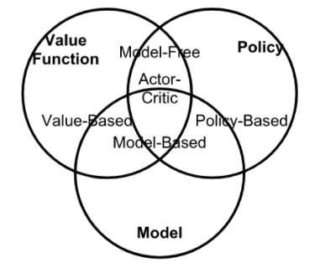
Types of Reinforcement Learning Algorithms
Model-based: Rely on the model of the environment; either the model is known or the algorithm learns it explicitly.
Model-free: No dependency on the model during learning.
On-policy: Use the deterministic outcomes or samples from the target policy to train the algorithm.
Off-policy: Training on a distribution of transitions or episodes produced by a different behaviour policy rather than that produced by the target policy.

Slide 7


Policy Gradient Theorem
Policy is the probability distribution or a function that provides the appropriate action for a particular state.
Mathematically defining the main objective of Policy gradient:
The objective function is updated using gradient Ascent (or Descent).

Slide 8
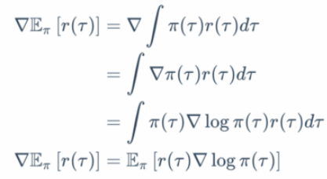

Policy Gradient Theorem
Thus the expectation function can be written as:
The Policy gradient theorem shows that the derivative of the expected reward is the exception of the product of the reward and gradient of the log of the policy.

Slide 9
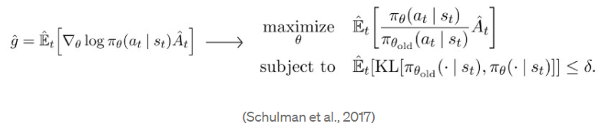
Proximal Policy Optimization
It is the current policy gradient method used till date
It is the best performing algorithm so far for stochastic problems and environments.
Based on the TRPO objective function:
The main idea from this objective function is that the policy updates are constrained so that it does not deviate too much.

Slide 10
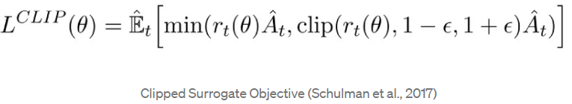
Proximal Policy Optimization
Objective function:
Thus the optimization is simplified while keeping the advantage of TRPO.
The important component of the equation is the second term where the objective function is clipped to be in between 1-epsilon and 1+epsilon.

Slide 11
Phasic Policy Gradient
It is a modified version of the PPO algorithm
The algorithm consists of training in two phases, the policy phase which follows the PPO algorithm and the Value phase which further updates the value function.
It uses buffers to store the previous experiences for training which makes the algorithm sample efficient.
In theory, the convergence of the objective function should be quicker.

Slide 12



Phasic Policy Gradient
The Policy phase objective:
The auxiliary phase objective:
Where the auxiliary loss is defined as:

Slide 13
Lunar Lander Environment
One of the environments in OpenAI gym
Target of the environment is that the lander has to land exactly in between the yellow flags without crashing.
The observation space:
x coordinate of the lander
y coordinate of the lander
vx the horizontal velocity
vy the horizontal velocity
(Theta) the orientation in space
v the angular velocity
Left leg touching the ground (Boolean)
Right leg touching the ground (Boolean)

Slide 14
Lunar Lander Environment
Action Space:
Left Engine
Right Engine
Main Engine
No action
Rewards obtained:
100-140 awarded for simply moving vertically towards the landing pad
Points are deducted when the lander moves away from the landing pad.
10 points are added for each of the lander leg touching the surface.
100 points are awarded for safe landing
100 points are deducted for crashing

Slide 15
Neural Network Structure
2 Networks: the Actor network or the policy network and the Critic network or the value network.
Both the networks have 3 layers with Tanh activation between the hidden layers and ReLU activation at the output layer.
Adam optimizer is used to optimize the loss function

Slide 16
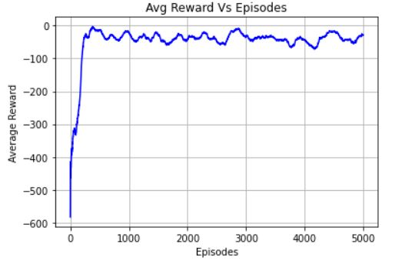
Result

Slide 17
Conclusion
This is one of the applications Reinforcement learning has.
Space exploration is very significant for the advancement of human kind.
The PPG Algorithm was successfully implemented for a simple agent.
There is room for improvement for the results.

Slide 18
References
https://lilianweng.github.io/lil-log/2018/02/19/a-long-peek-into-reinforcement-learning.html
https://towardsdatascience.com/policy-gradients-in-a-nutshell-8b72f9743c5d
https://towardsdatascience.com/understanding-and-implementing-proximal-policy-optimization-schulman-et-al-2017-9523078521ce
https://gym.openai.com/envs/LunarLander-v2/
https://www.davidsilver.uk/wp-content/uploads/2020/03/intro_RL.pdf

